Slide 1
Weekly report: Rotor Blade Design
Week number: 08
Date: 18/11/2025
Supervisor:Prof. Dr. rer.nat. Alois Schaffarczyk
Presented by: Kandarp Pathak / Jay Pandya, Harsh Panchal, Daniyal Sikander
18.11.2025
1
Kandarp Pathak
Rotor Blade Design/ Optimus Syria

Slide 2
List of contents
Final Blade Geometry
Power Co-efficient Vs Tip speed ratio Graph
Power Vs Wind speed Graph
18.11.2025
Kandarp Pathak
Rotor Blade Design / Optimus Syria

Slide 3
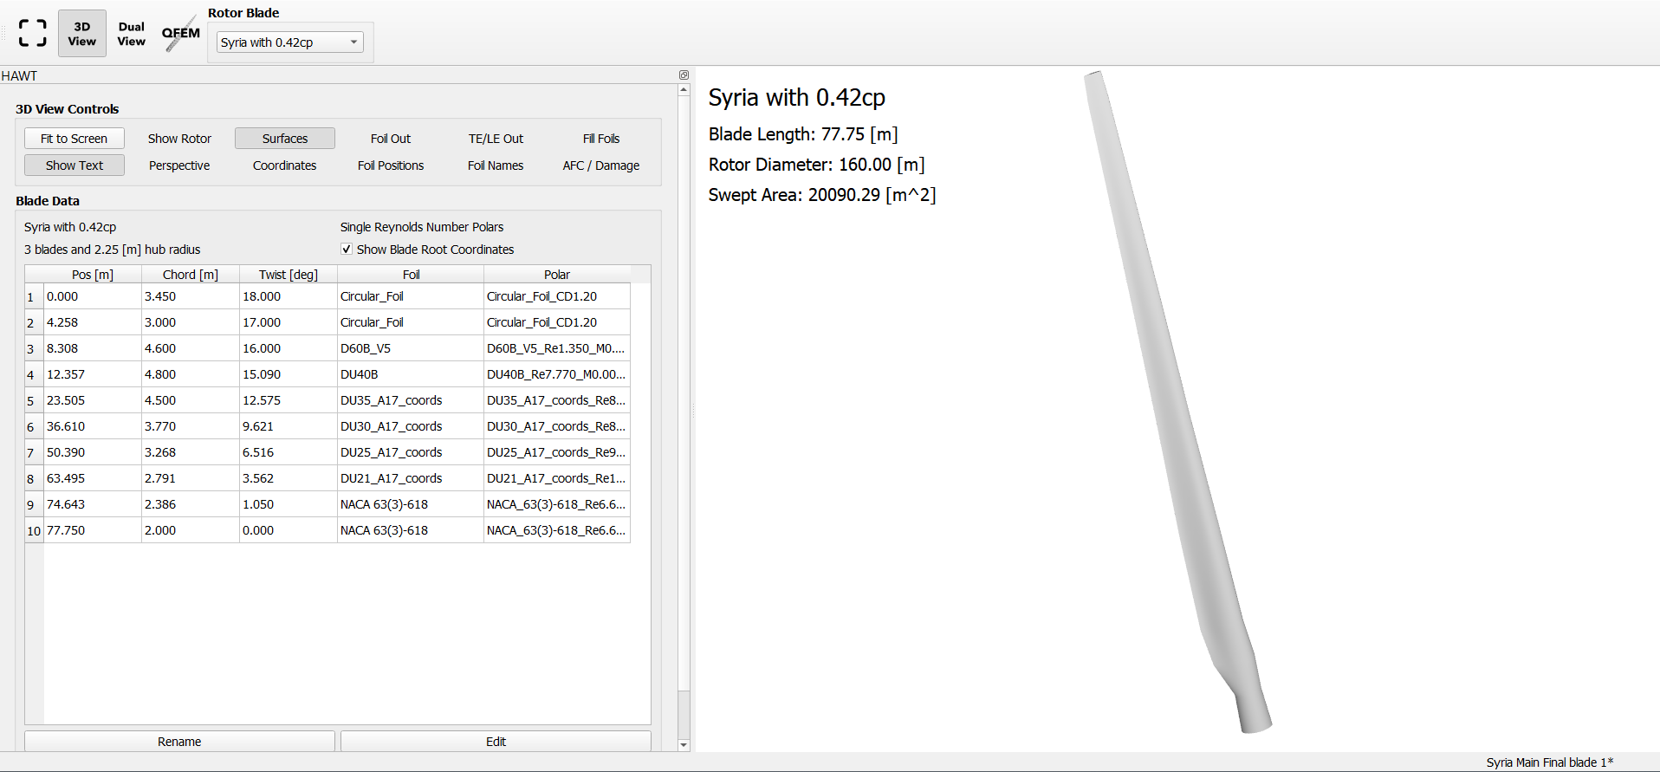
Final Blade Geometry
Source – Self Generated in Q-Blade
18.11.2025
Kandarp Pathak
Rotor Blade Design / Optimus Syria

Slide 4
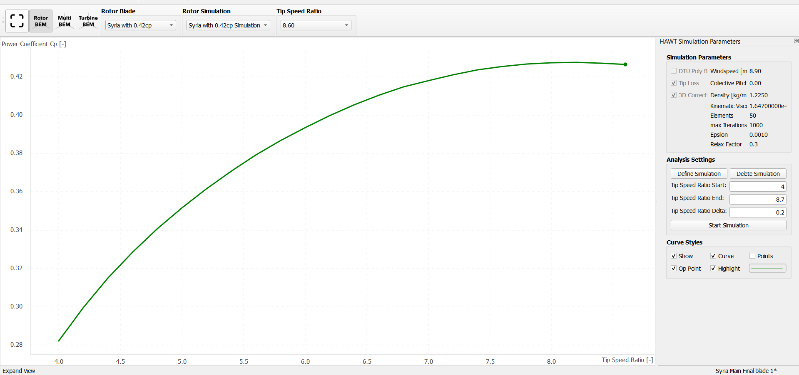
Power Co-efficient Vs Tip speed ratio Graph
Cp = 0.427 at TSR = 8.4
Cp = 0.426 at TSR = 8.6
Source – Self Generated in Q-Blade
18.11.2025
Kandarp Pathak
Rotor Blade Design / Optimus Syria

Slide 5
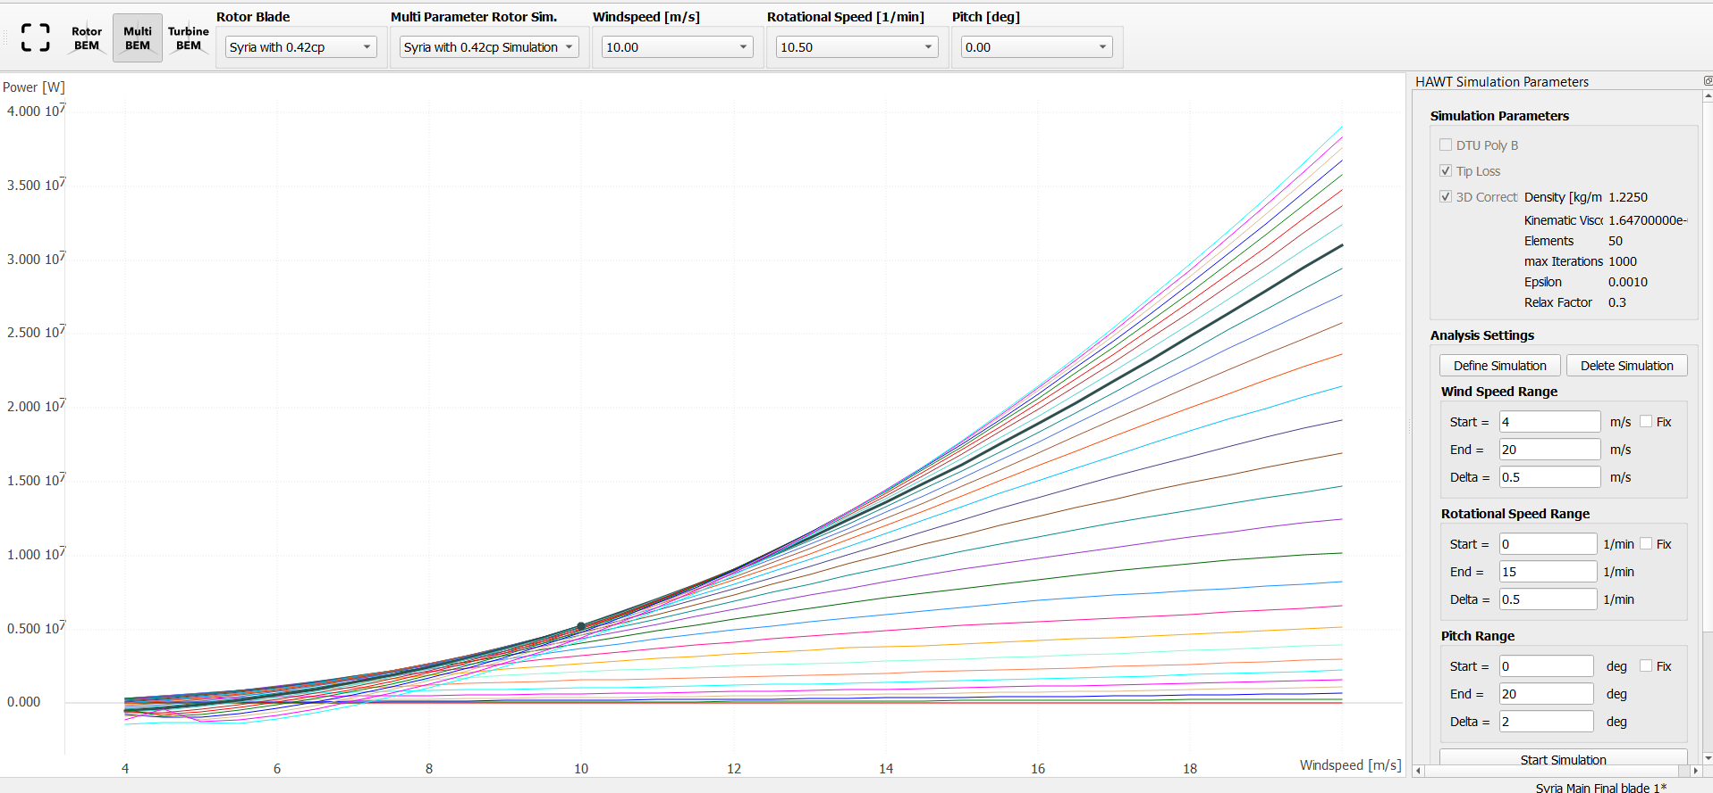
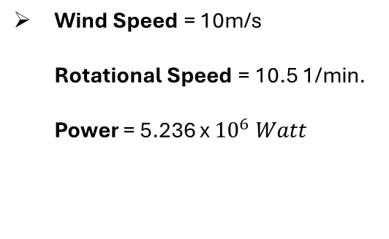
Power Vs Wind speed Graph
Wind Speed = 10m/s
Rotational Speed = 10.5 1/min.
Power = 5.236 x ${10}^{6} Watt$
Source – Self Generated in Q-Blade
18.11.2025
Kandarp Pathak
Rotor Blade Design / Optimus Syria

Slide 6
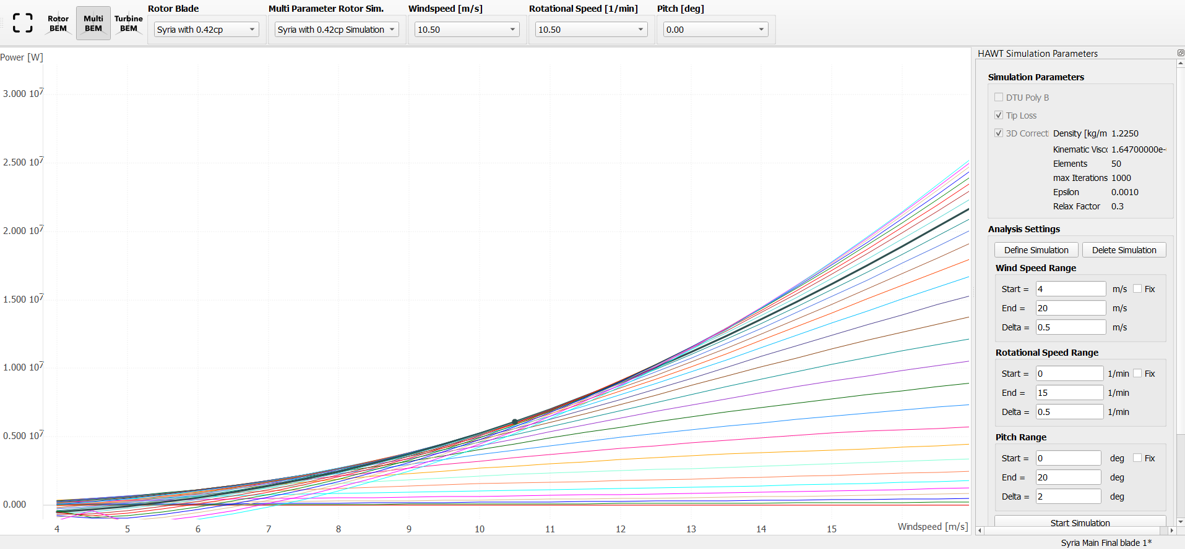
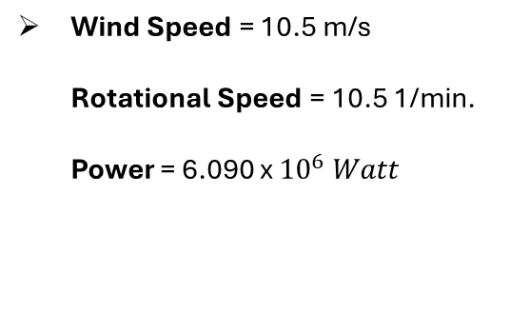
Power Vs Wind speed Graph
Wind Speed = 10.5 m/s
Rotational Speed = 10.5 1/min.
Power = 6.090 x ${10}^{6} Watt$
Source – Self Generated in Q-Blade
18.11.2025
Kandarp Pathak
Rotor Blade Design / Optimus Syria

Slide 7
Bibliography
Self Generated Content (17.11.2025)(10:00)
18.11.2025
Kandarp Pathak
Rotor Blade Design / Optimus Syria

